Slide 1
GIT and GITHub

Slide 2
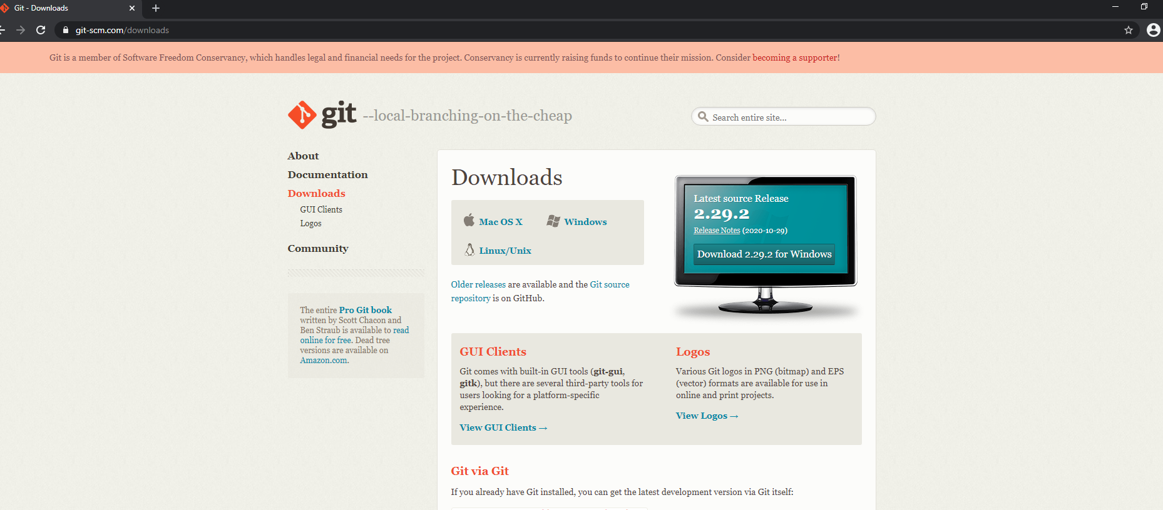
Download and Install Git

Slide 3
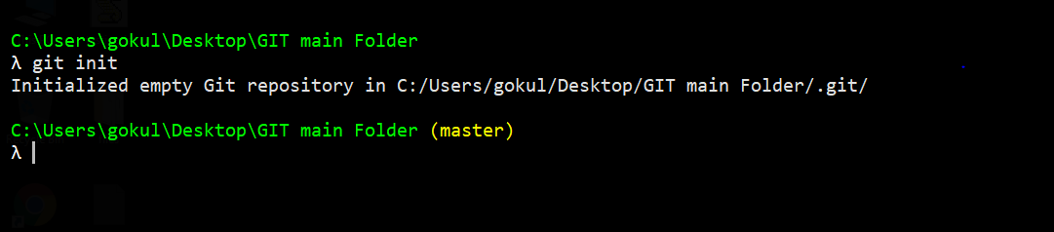
Git Init

Slide 4

Add files

Slide 5
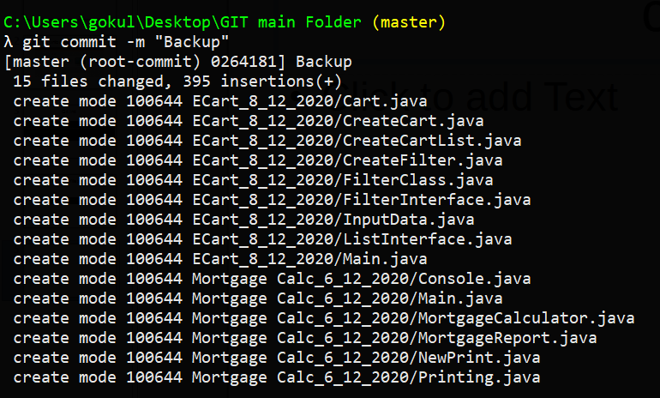
commit

Slide 6
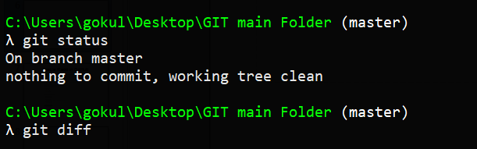
Git status and Diff after commit

Slide 7
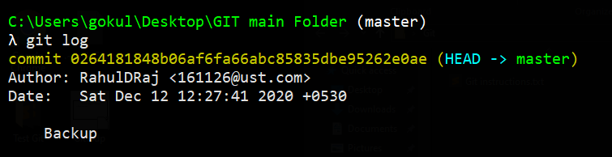
Git log

Slide 8
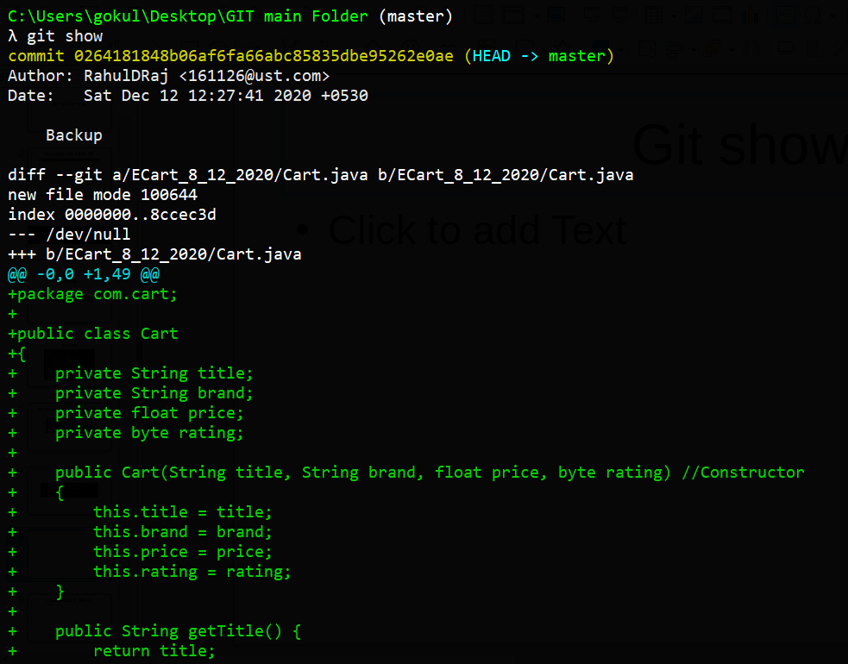
Git show

Slide 9
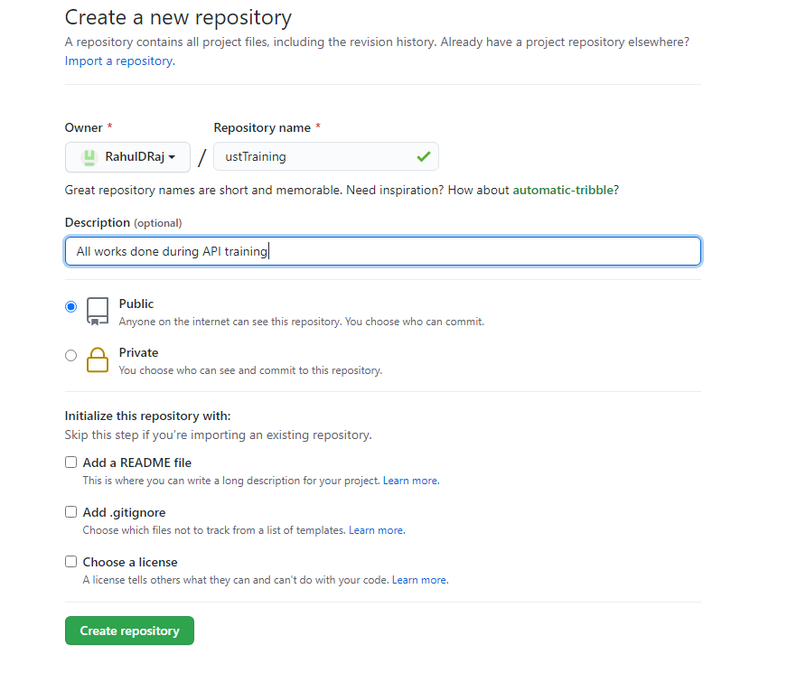
Create Repo in GitHub

Slide 10
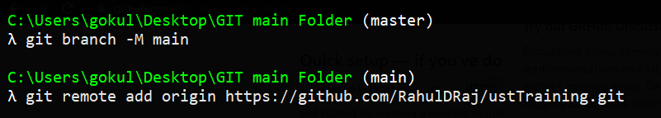
Create branch and remote add

Slide 11
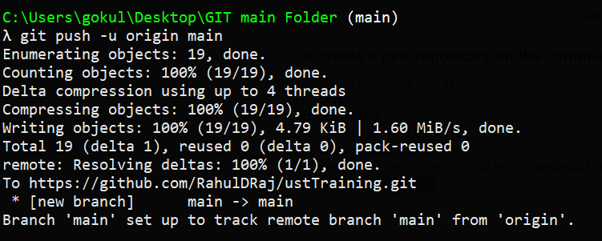
Git push

Slide 12
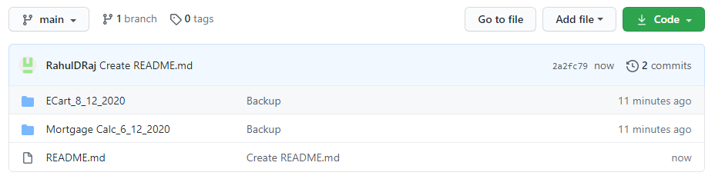
GitGub repo after push

